Slide 1
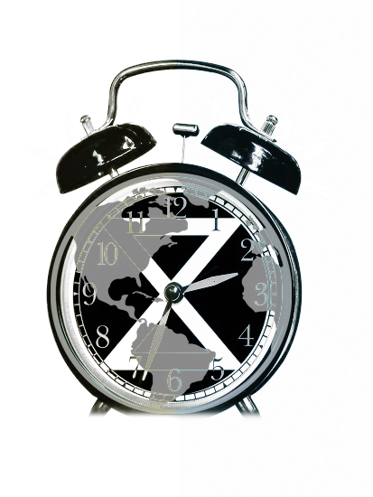
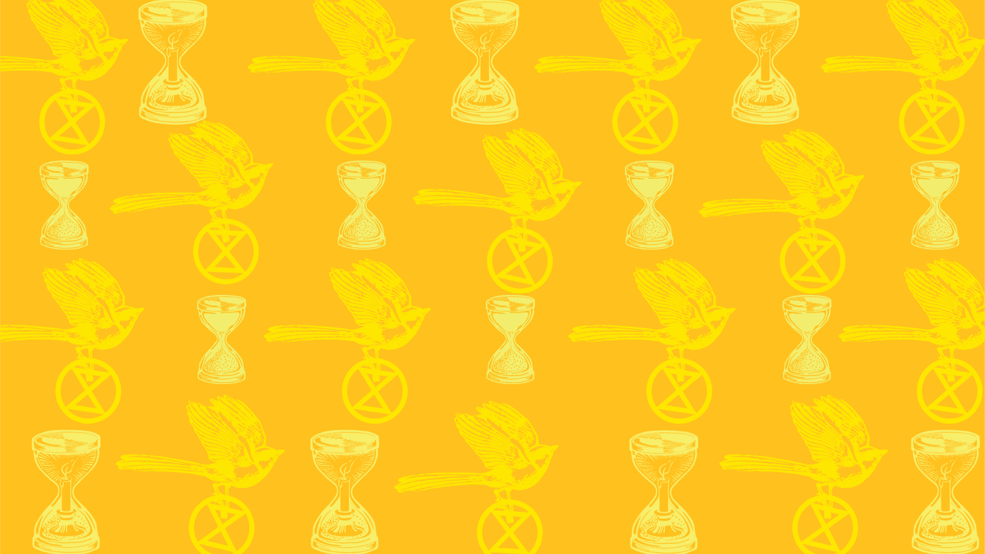
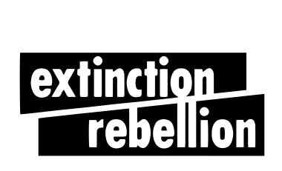
What do we want?
When do we want it?
Climate Justice
Now!

Slide 2
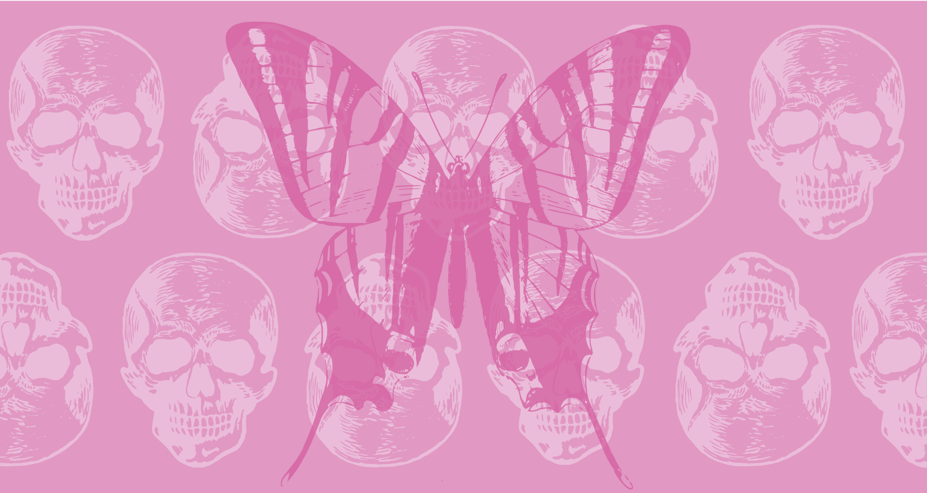
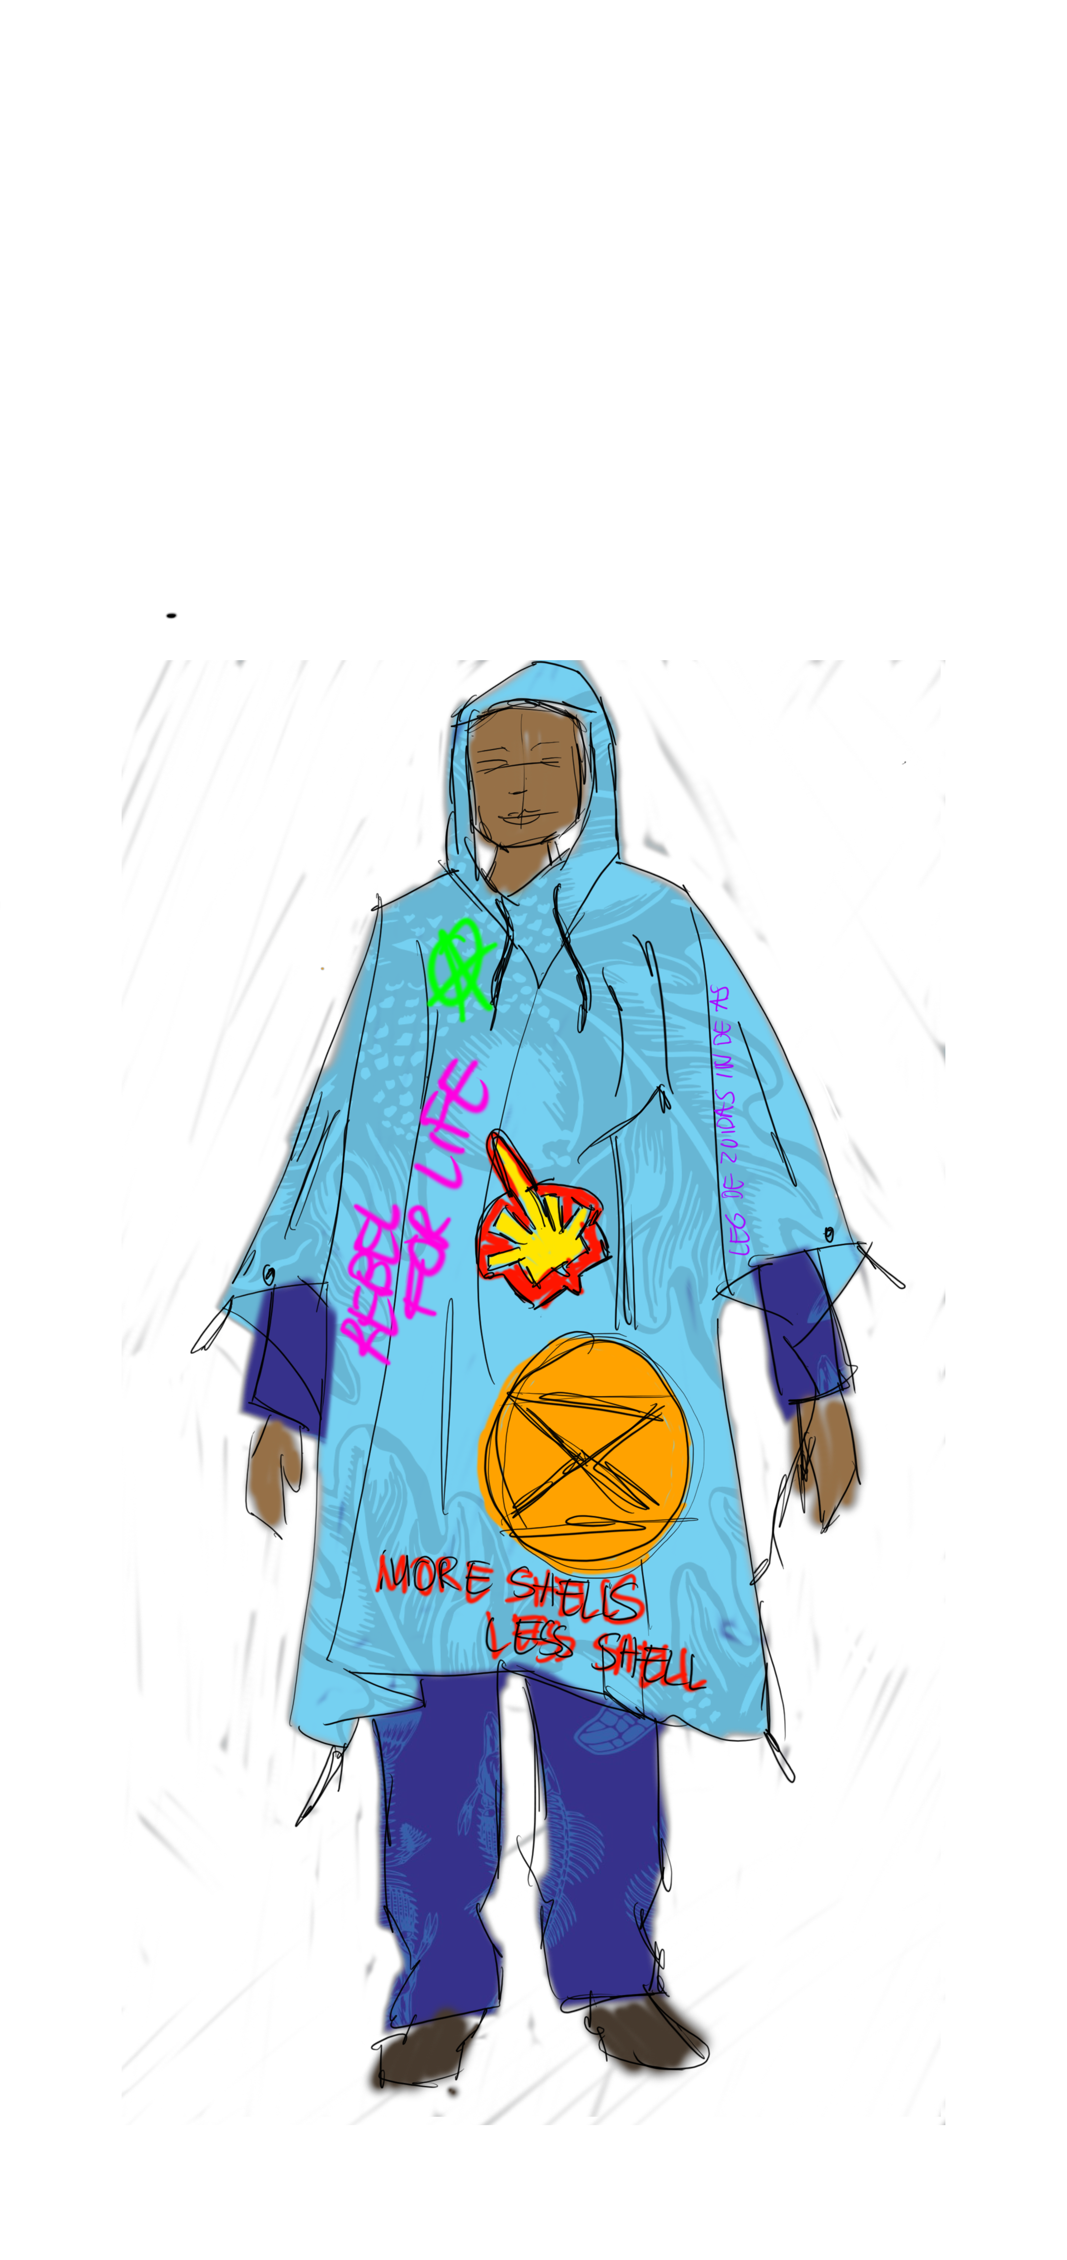
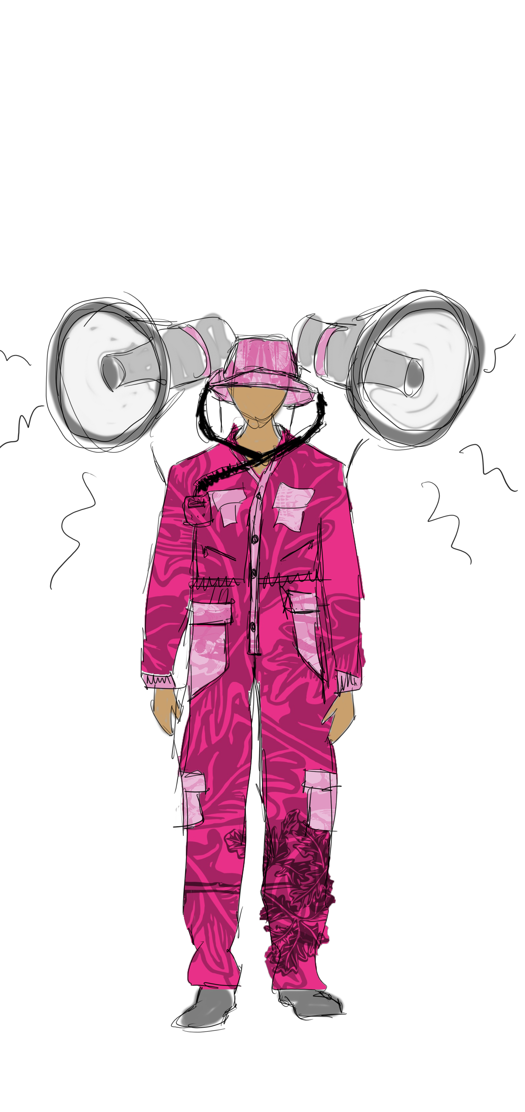
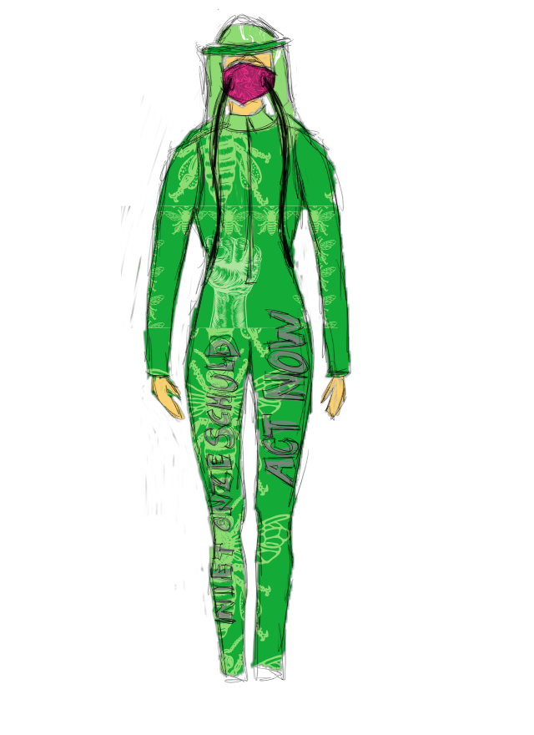
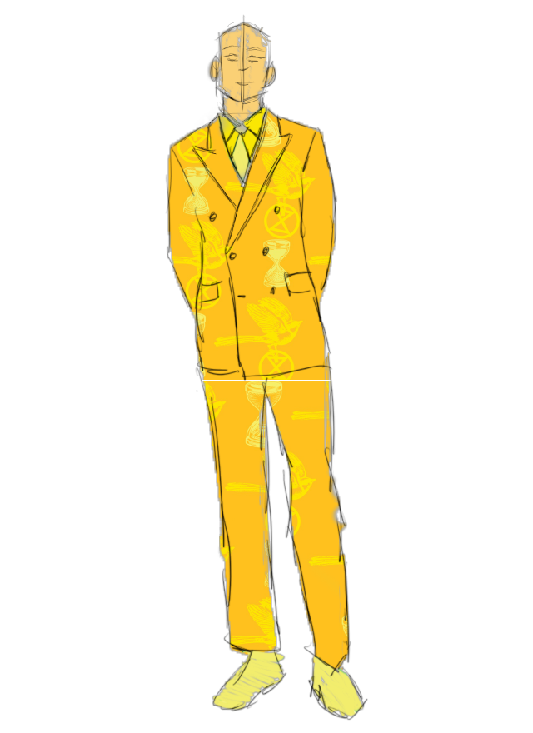
What
A phygital open-source biodegradable collection that can be worn during and supports an Extinction Rebellion blockade

Slide 3
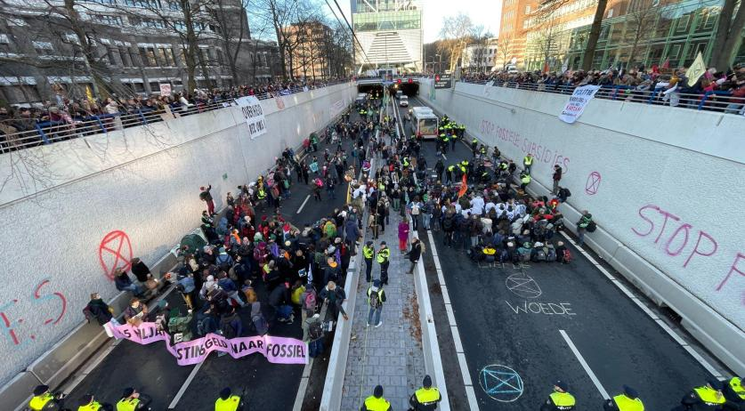
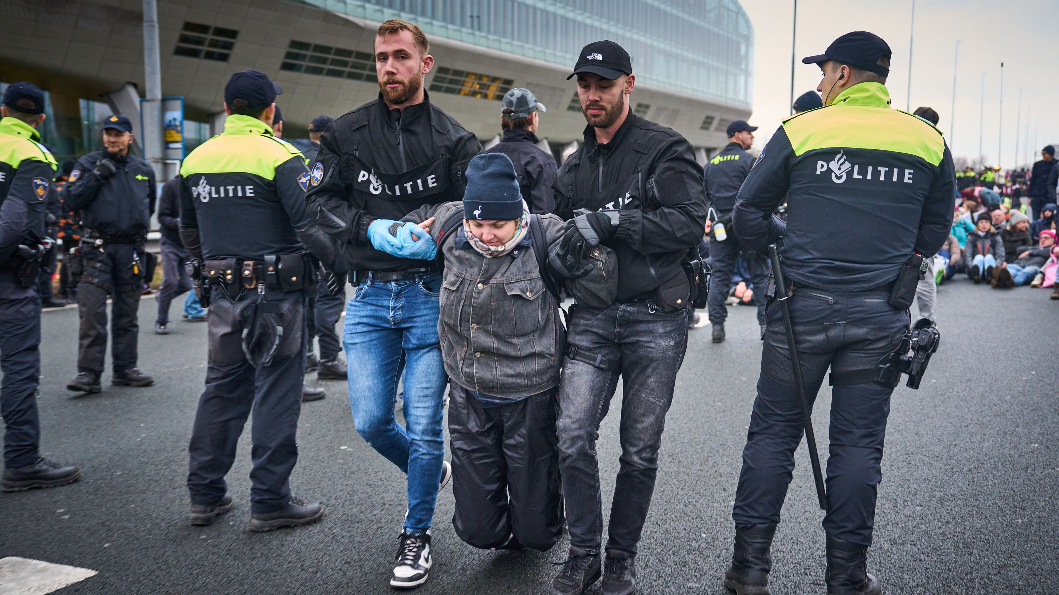
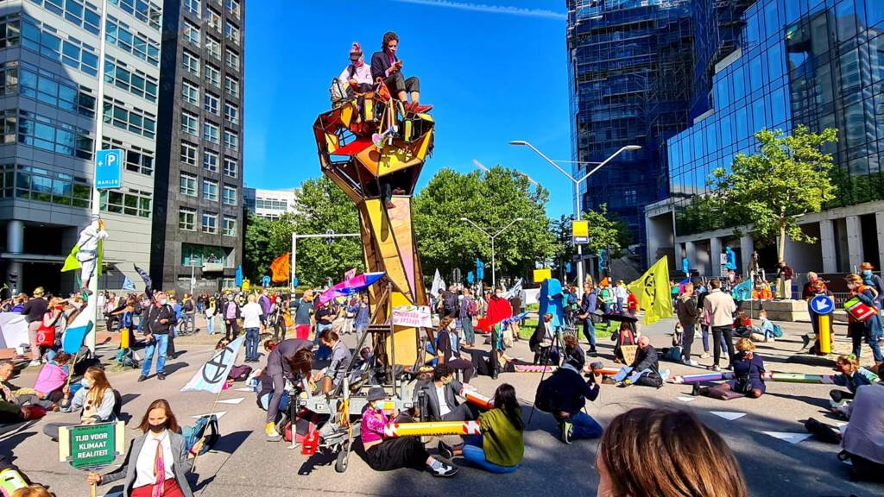
What
What is Extinction Rebellion?
A climate movement
Demands
Climate justice for all
Tell the truth
Act now
Decide together
Famous protests
A12
A10
De Zuidas

Slide 4
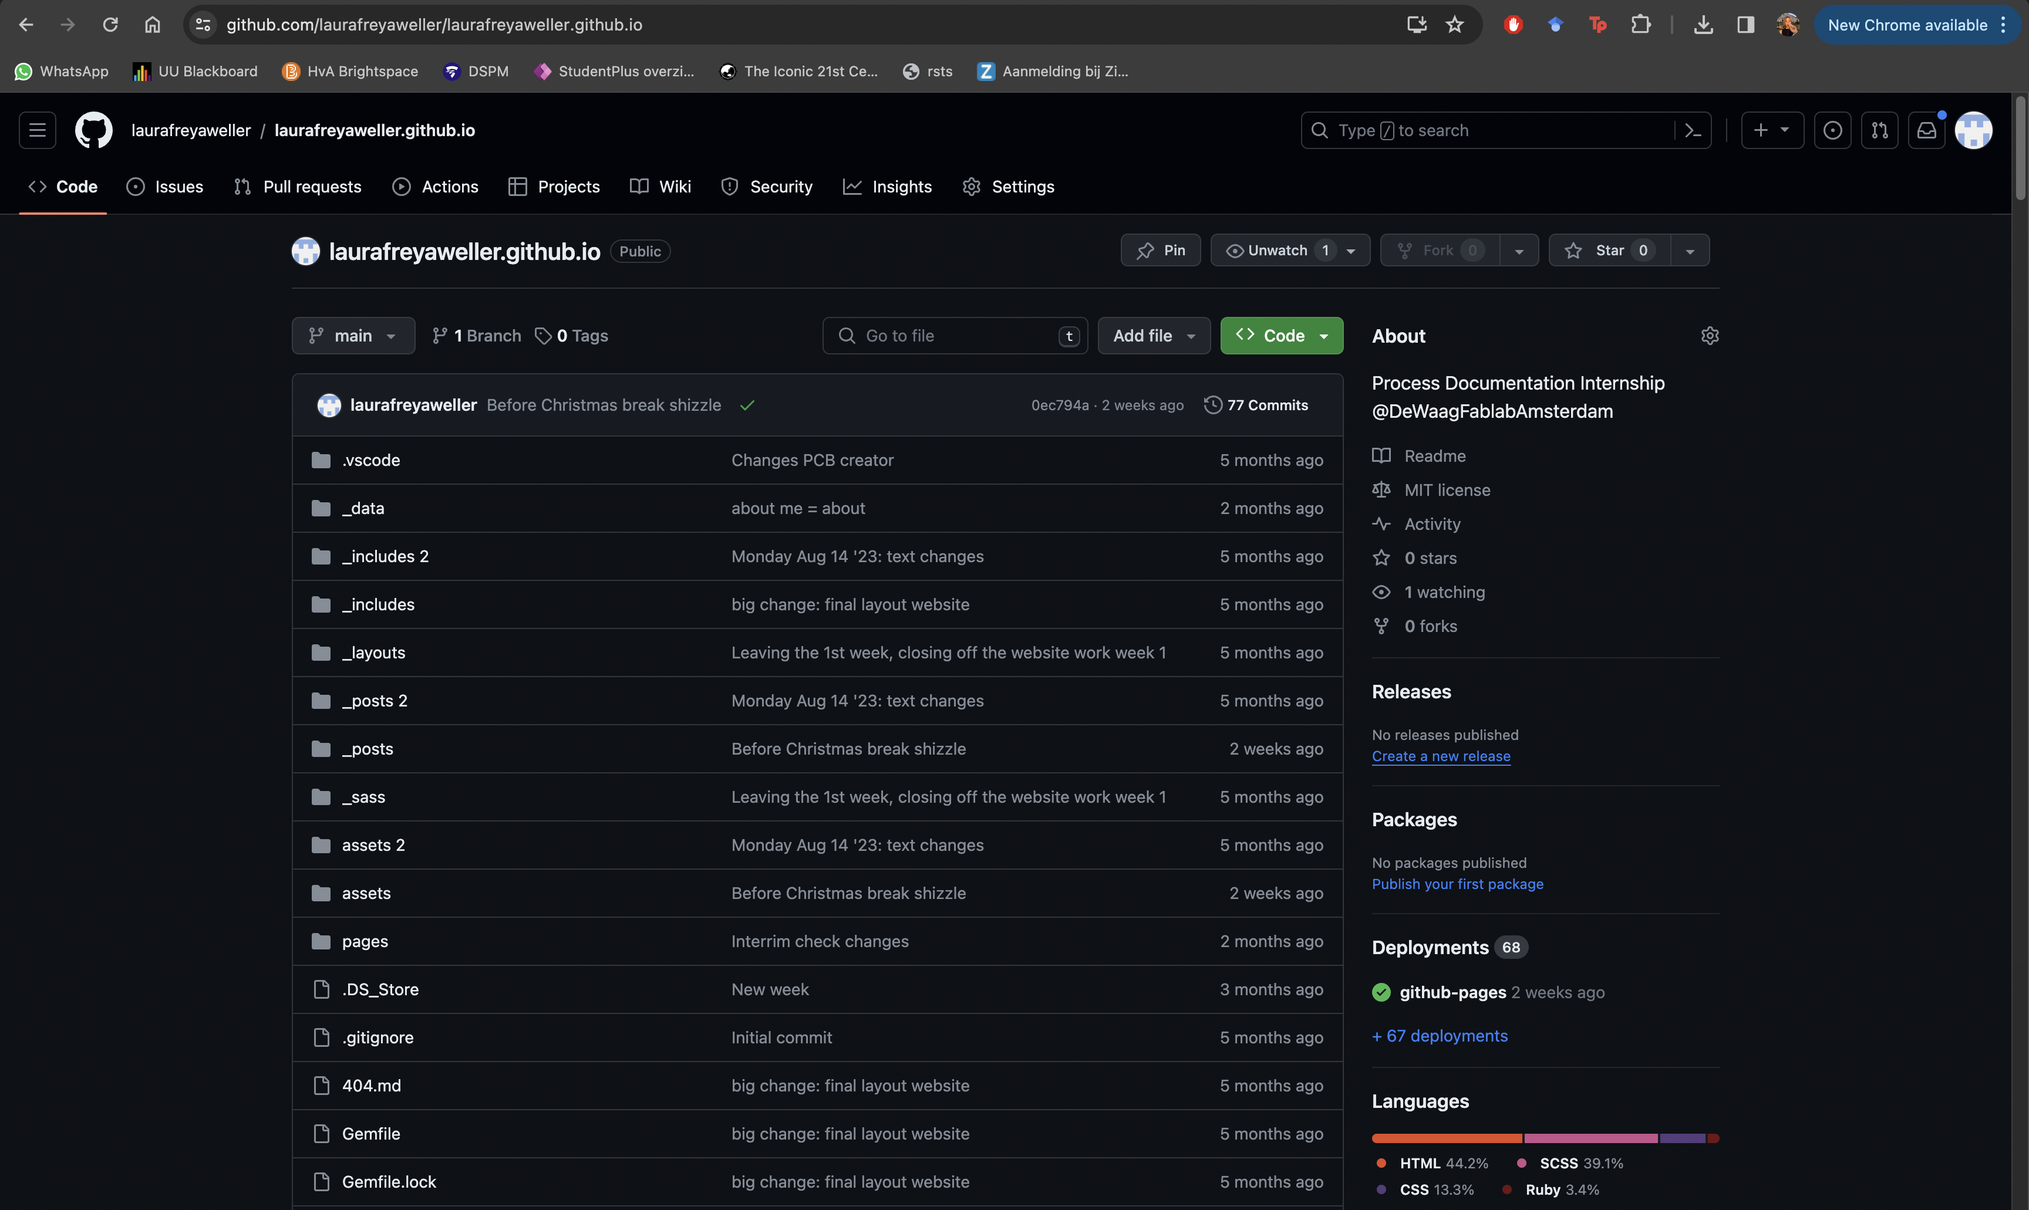
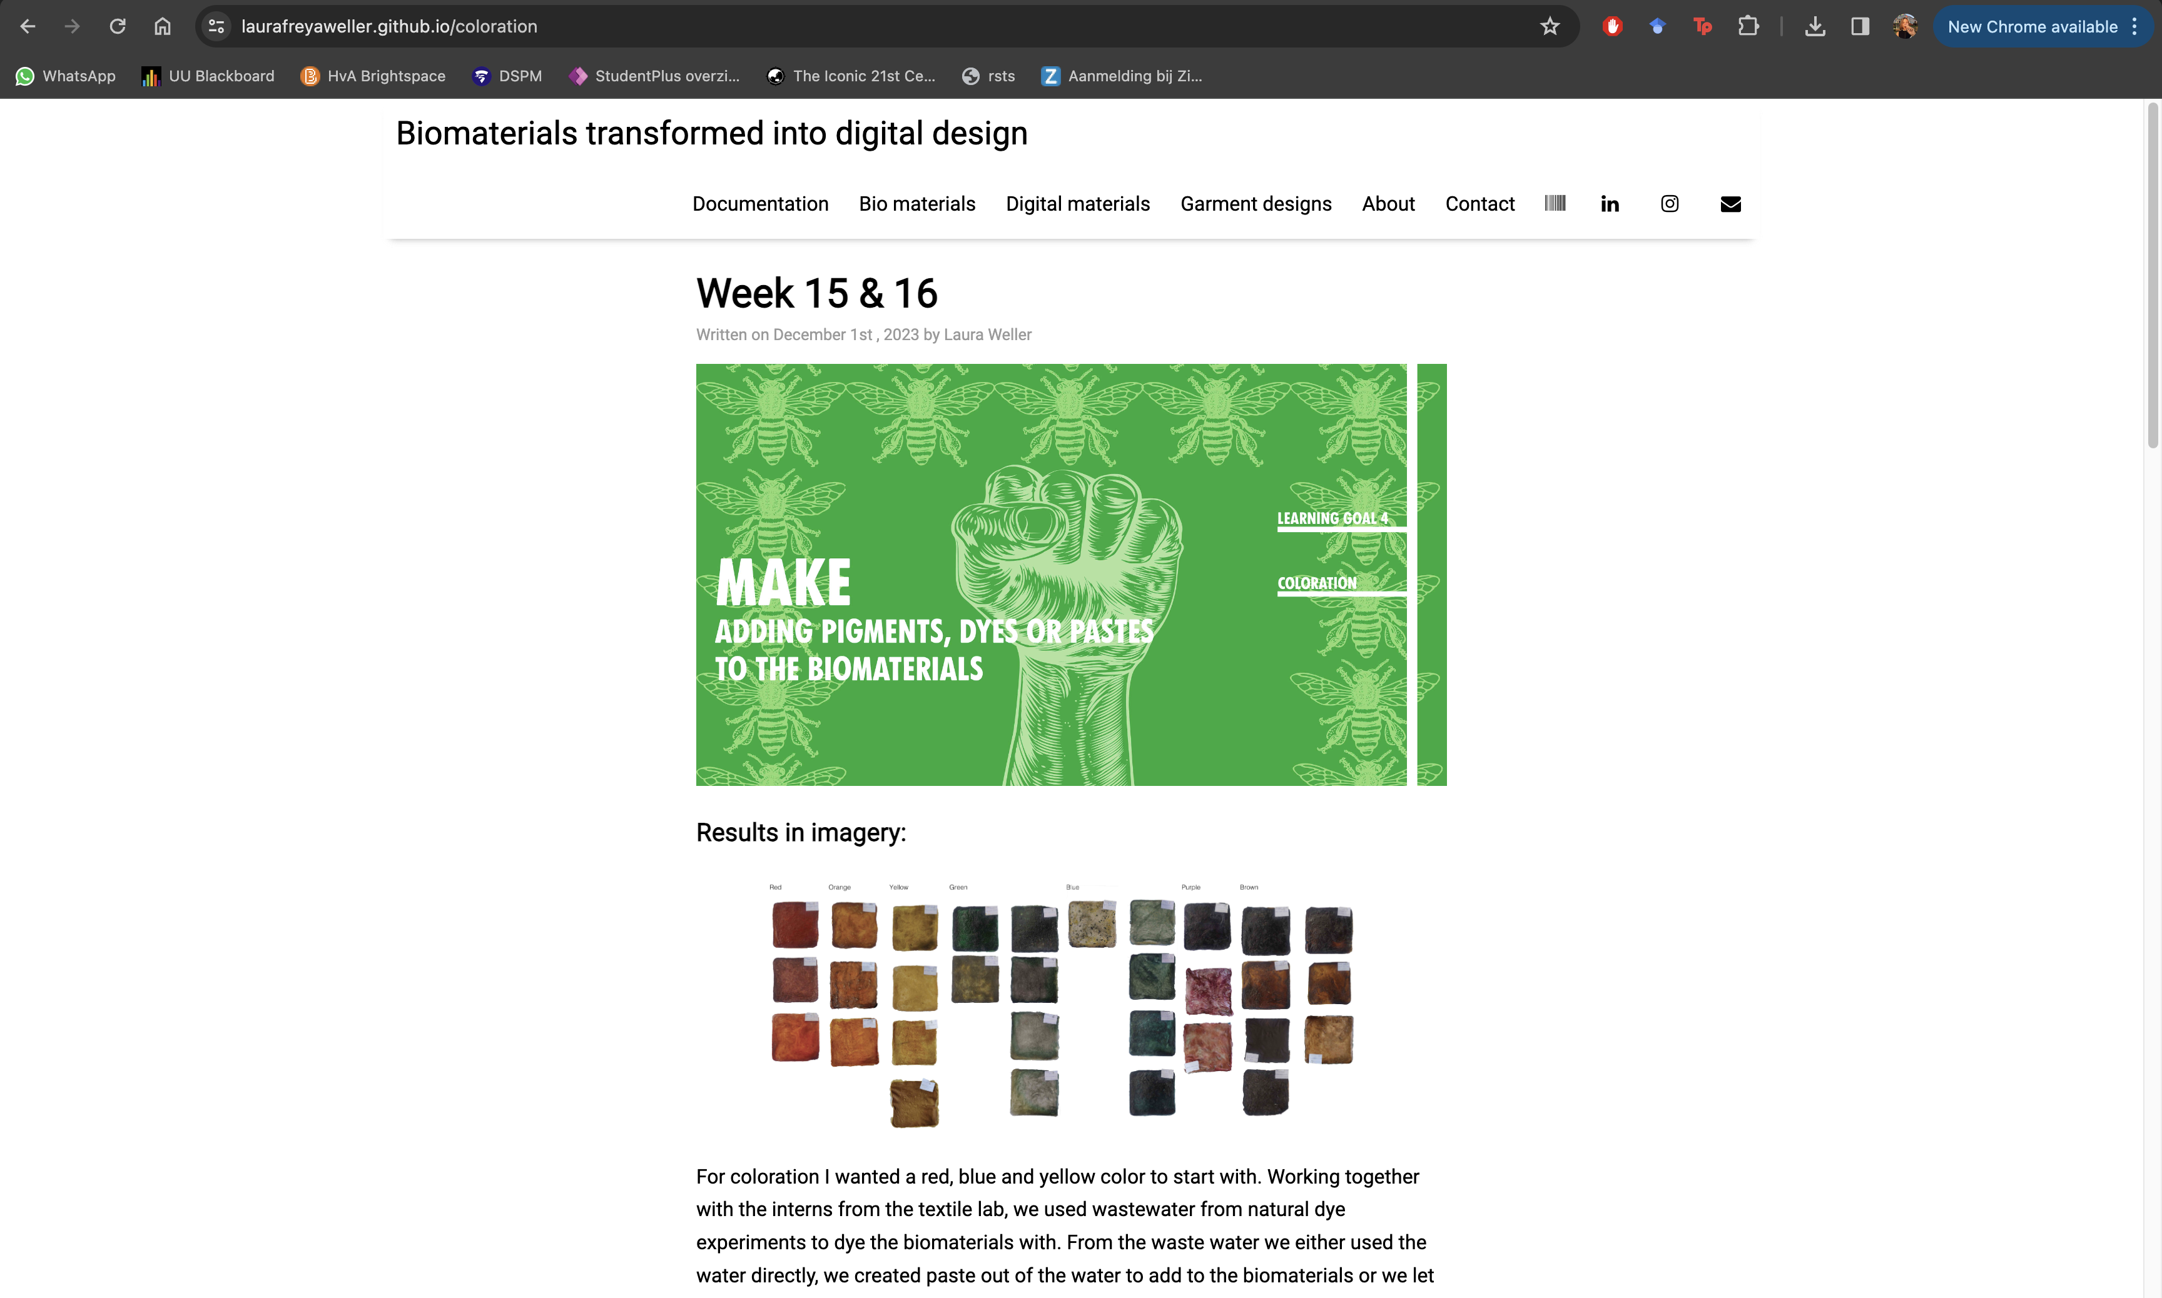
What
What is phygital open-source biodegradable collection?
A both digital and physical collection that anyone can replicate through using the GitHub platform and can compost from 2 months till 2 years.

Slide 5
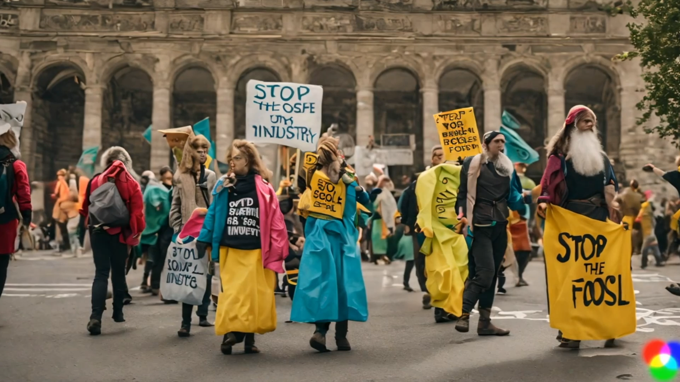
What
Target group & communication
Activist, Mattermost & GitHub

Slide 6

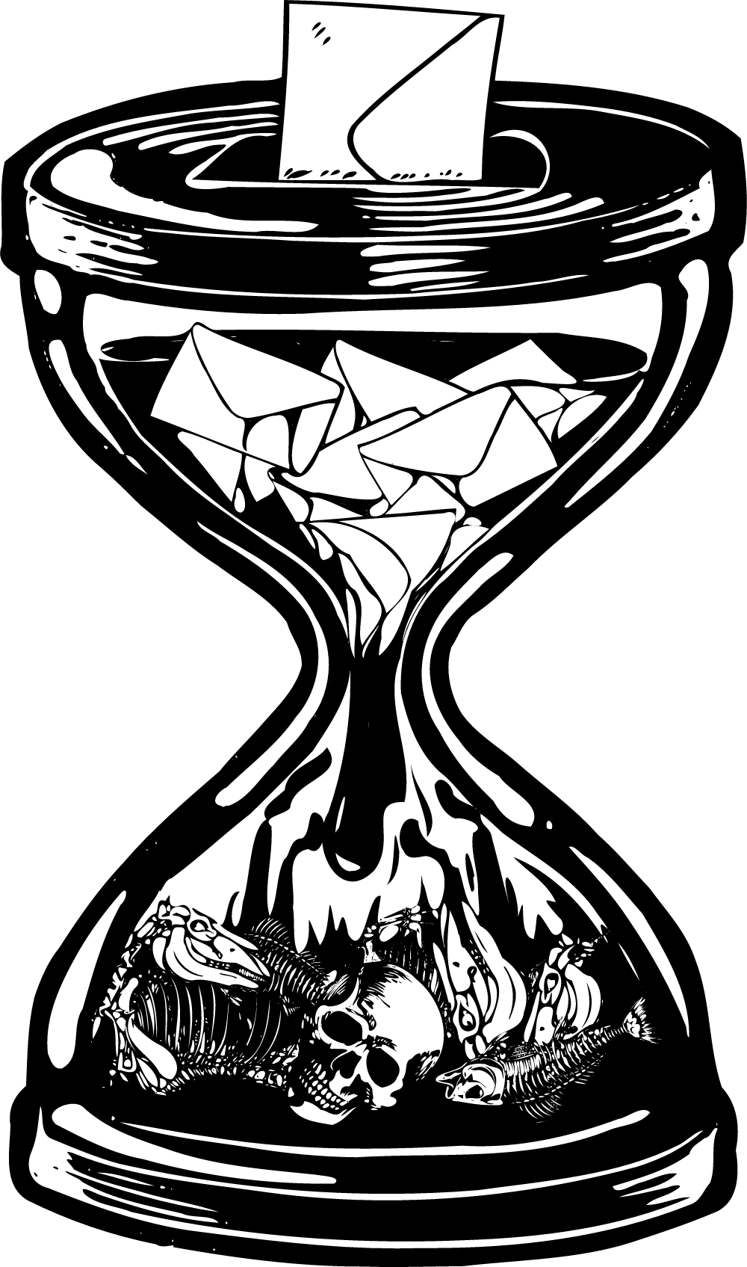
Why
Why this collection?
We are living in a climate crisis. Extinction Rebellion is showing civil disobedience to enforce proper climate justice and policy. The freedom in form of protest of Extinction Rebellion causes the opportunity for artivism, like this collection. The usage of Biodegradable materials fits Extinction Rebellion due to the demand of Extinction Rebellion which is rooted in the ecological crisis whereas biomaterials can play a role in the solution of this same ecological crisis.

Slide 7



How
Research, study and design
Attending the blockades
Rebel interviews
material research
~
Archetypical garment Study
~
Fashion design
Digitize materials

Slide 8

How
PLanning
Aug | Sept | Oct | Nov | Dec | Jan | Feb | Maart | April | Mei | Juni
Finished research paper | Finished Rebel Interviews | Finished little samples | Finished fabric recipes | Finished molds | Finished 3D samples of finishings | Finished big materials in molds | Finished design ideas (6 looks) | Finished toiles | Finished all digital designs | Finished physical look(s)
Finished website understanding for documentation | Finished research on civil disobedience | Finished understanding De Waag and machines |  | Finished color research | Finished archetypical garment study | Finished digitalising materials |  | Finished finishings for garments 3D printed | Finished line up + finished renders | Finished photoshoot and other deliverables

Slide 9
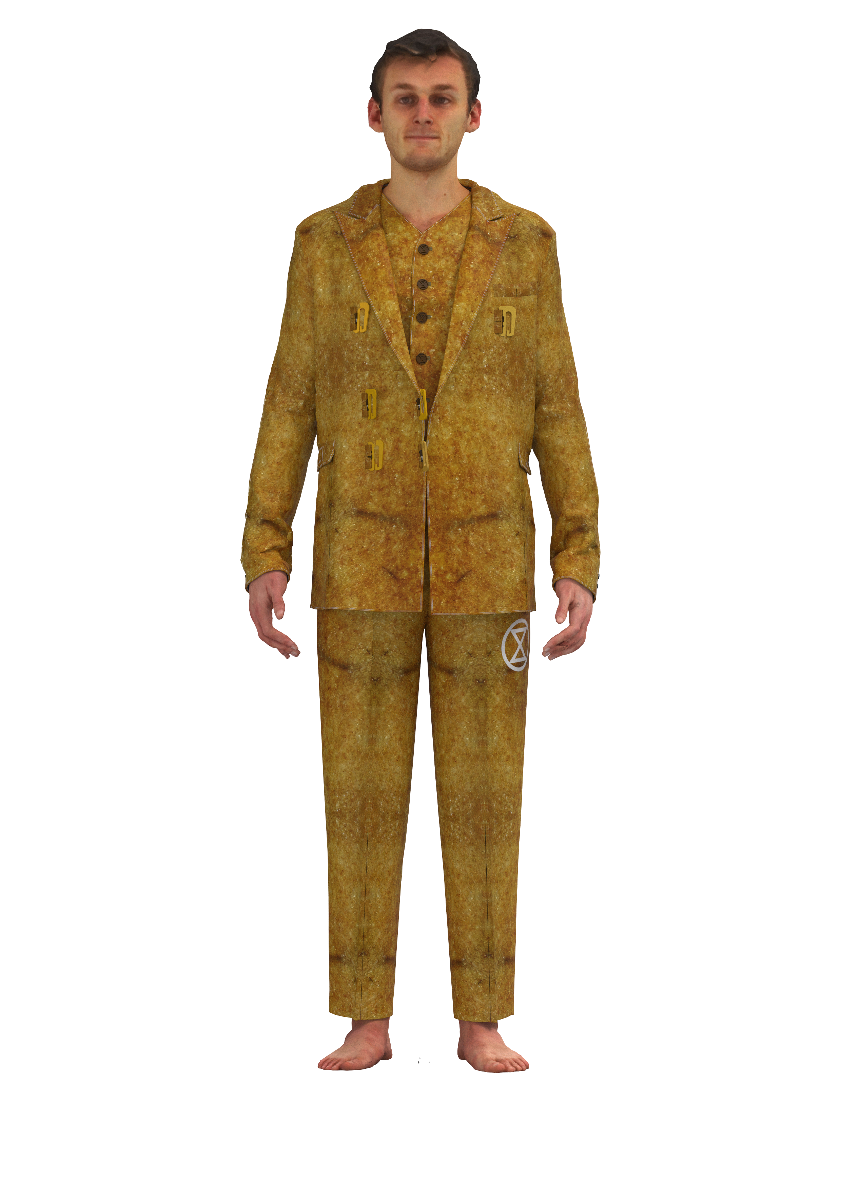
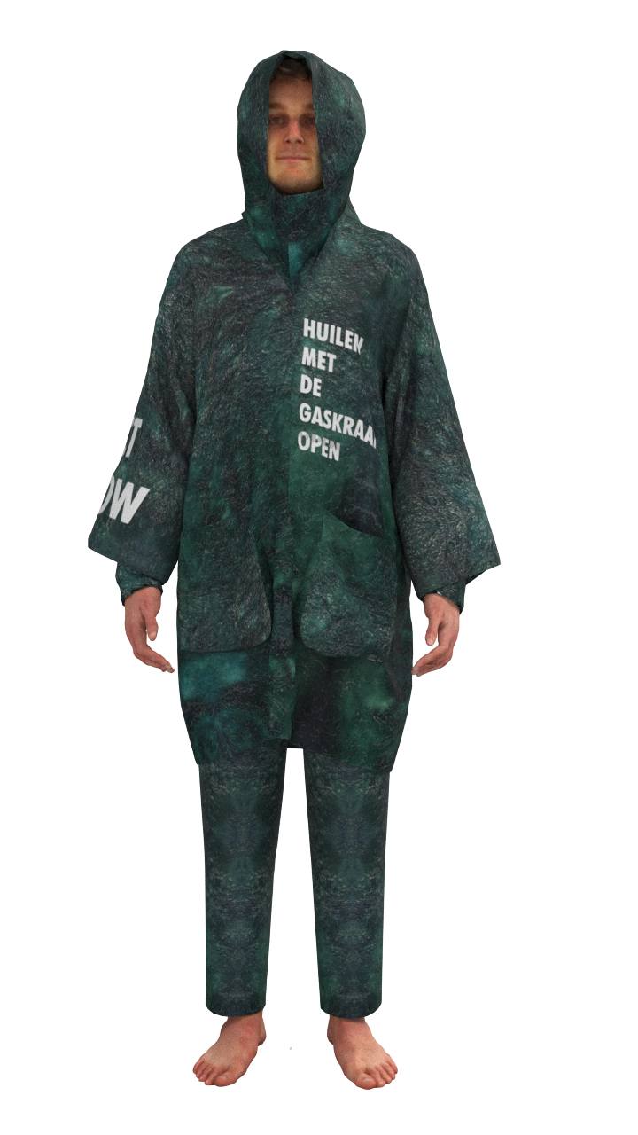
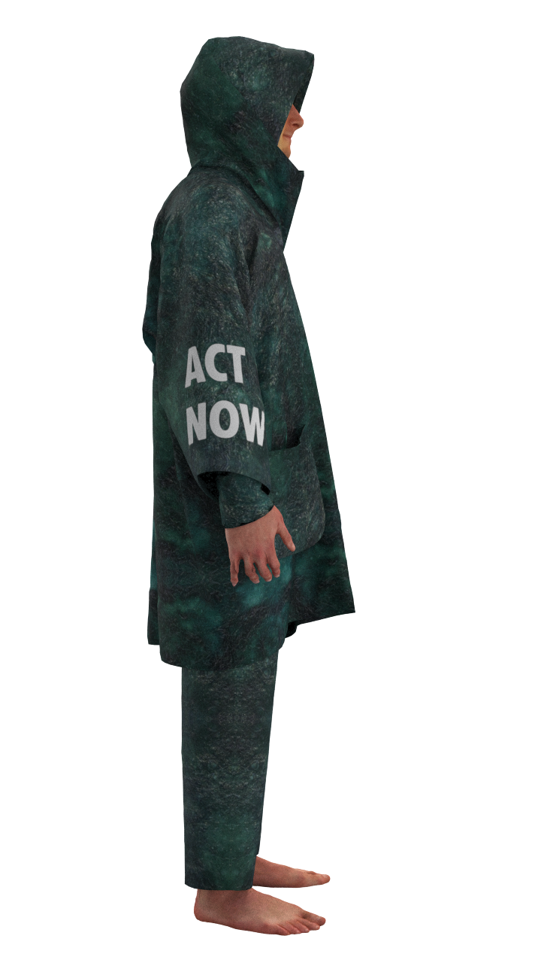
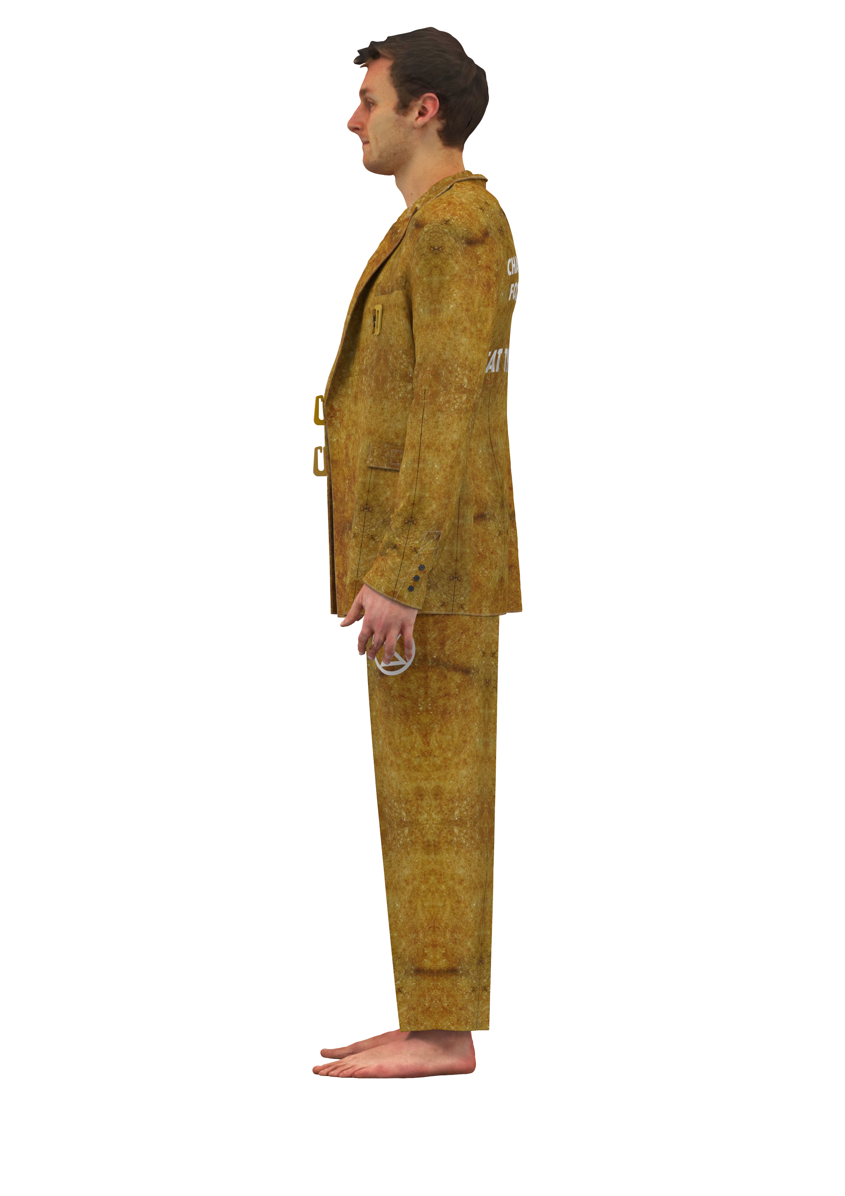
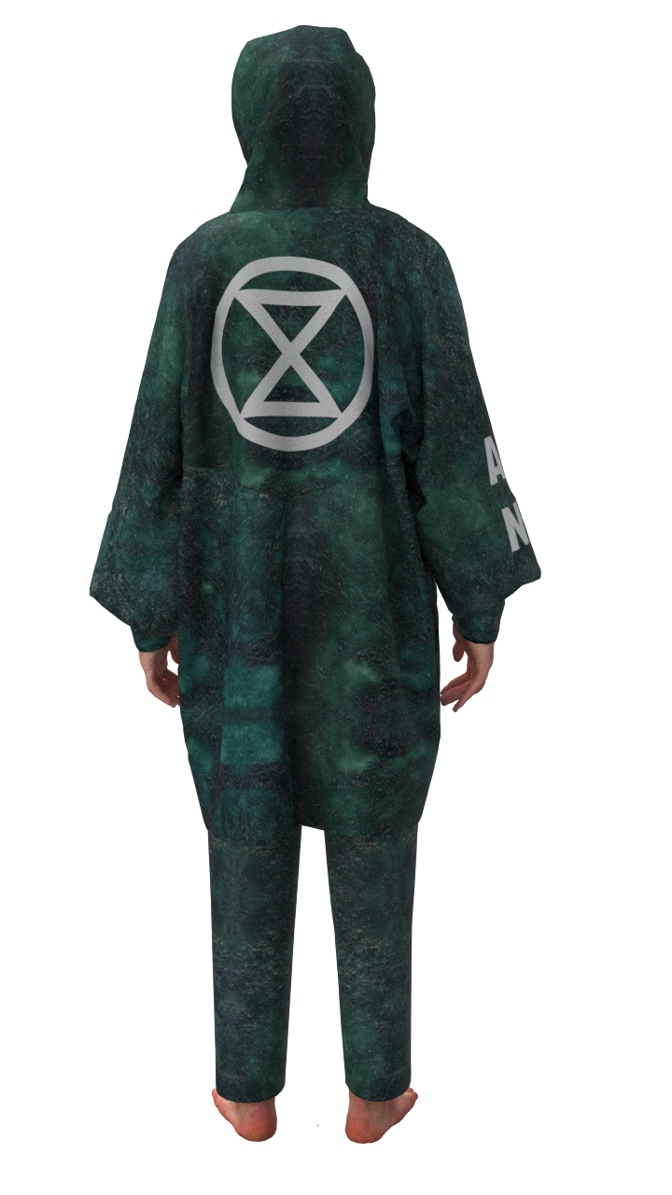
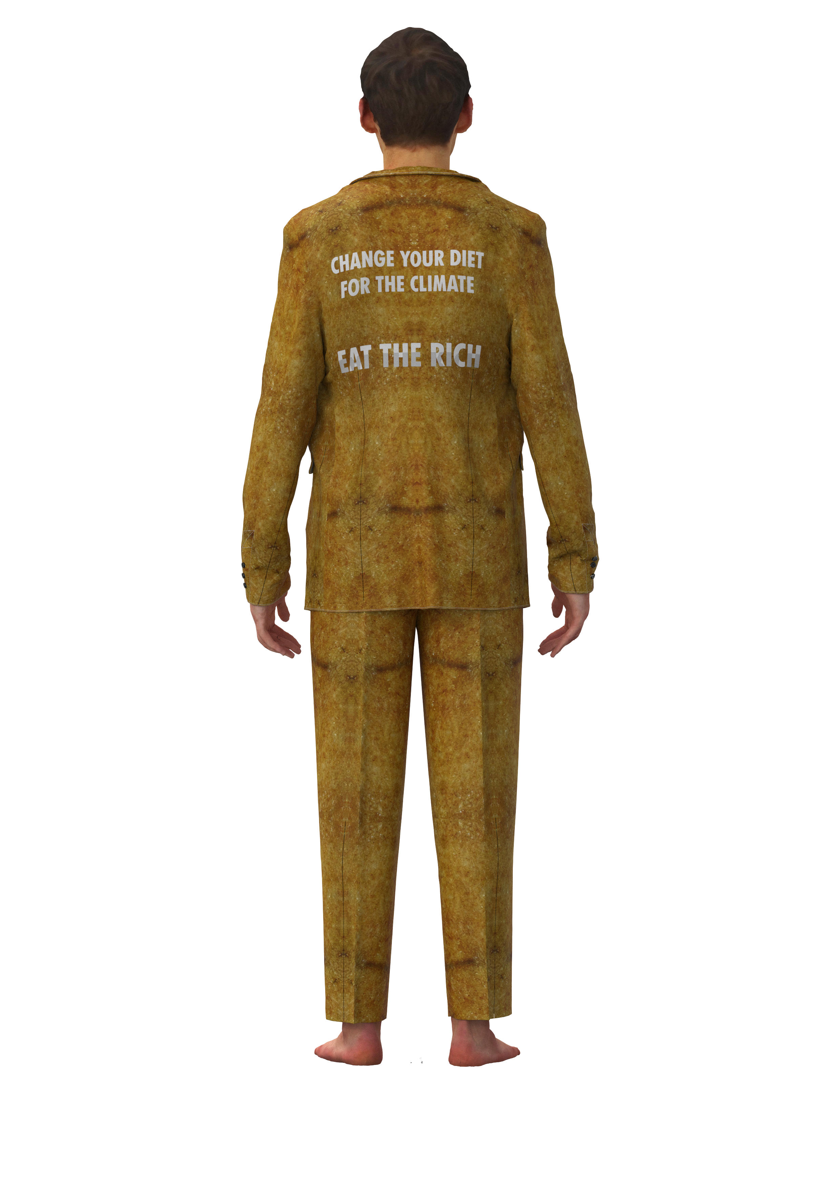
What
A phygital open-source biodegradable collection that can be worn during and supports an Extinction Rebellion blockade

Slide 10
What, why, how
What
A phygital open source biodegradable collection that can be worn during and supports an Extinction Rebellion blockade
Why
We are living in a climate crisis. Extinction Rebellion is showing civil disobedience to enforce proper climate justice and policy. The freedom in form of protest of Extinction Rebellion causes the opportunity for artivism, like this collection. The usage of Biodegradable materials fits Extinction Rebellion due to the demand of Extinction Rebellion which is rooted in the ecological crisis whereas biomaterials can play a role in the solution of this same ecological crisis.
How
By researching bio degradable materials, attending protests, interviewing rebels, study practical archetypes of protest garments and digitalizing the final biodegradable materials I am able to realize this collection.

